Slide 1
Ads flip classroom
222054_Mitkumar paul
222055_Toyesh Shende 222056_Mohini shendye
222057_Shreyash shete 222058_Utkarsh shinde
Implementation of hash table using linear probing with Chaining and without replacement

Slide 2
Index
Intro to hash table
Linear probing
Linear probing with chaining
Linear probing with chaining with replacement
Linear probing with chaining without replacement

Slide 3
Introduction to Hash table and Hashing :
Hash value | Index
 | 0
91 | 1
52 | 2
83 | 3
24 | 4
 | 5
 | 6
67 | 7
48 | 8
 | 9
Hashing ( Storing and Retrieving data in 0(1) time )
Hash table :
Hash function :
K mod 10, K mod n, Mid square, Folding method
Search keys :
Eg. (24, 52, 91, 67, 48, 83)

Slide 4
Linear probing
•Hash function:-
h(k) = k mod 10
•Keys = 43, 135, 72, 23, 99, 19, 82
•h(k,i) = (h(k) + i) mod 10
(i -> collision/probe number)

Slide 5
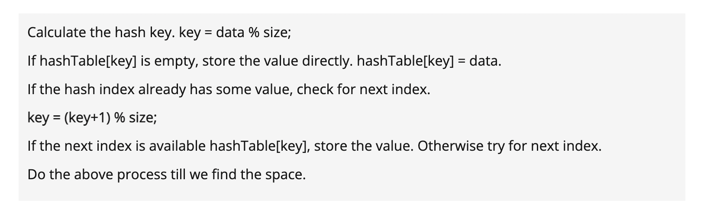
Steps for linear probing

Slide 6
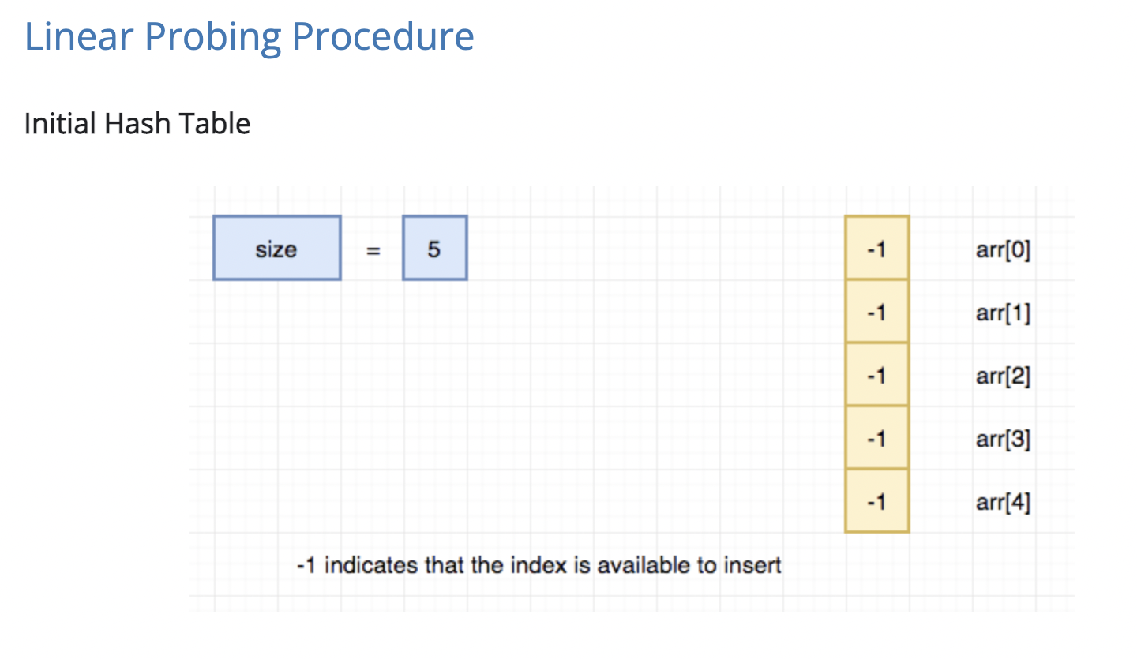
Here we see the EXAMPLE:-

Slide 7
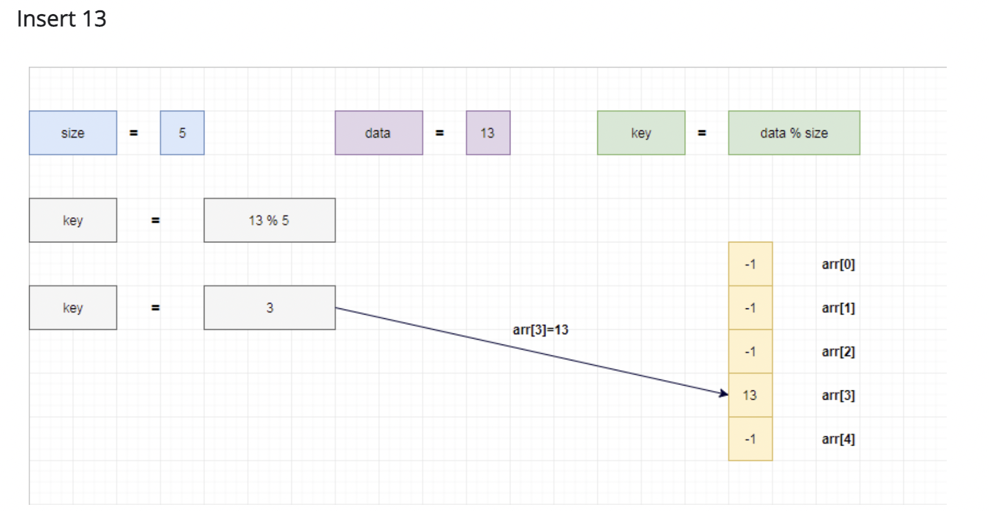
Insert 13

Slide 8
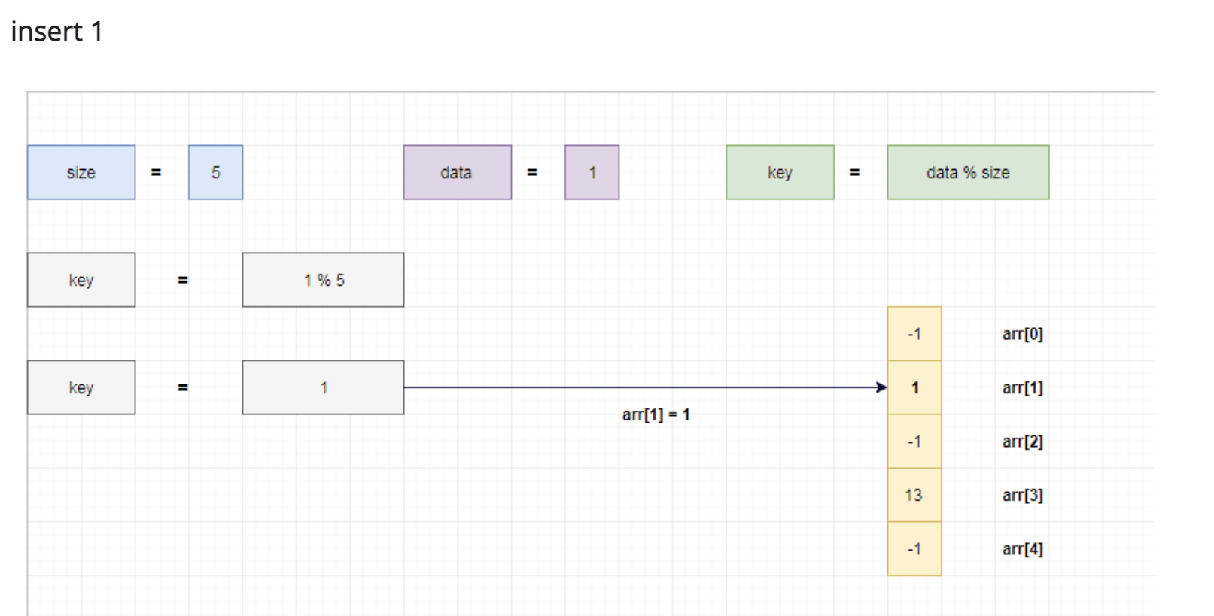
Insert 1

Slide 9
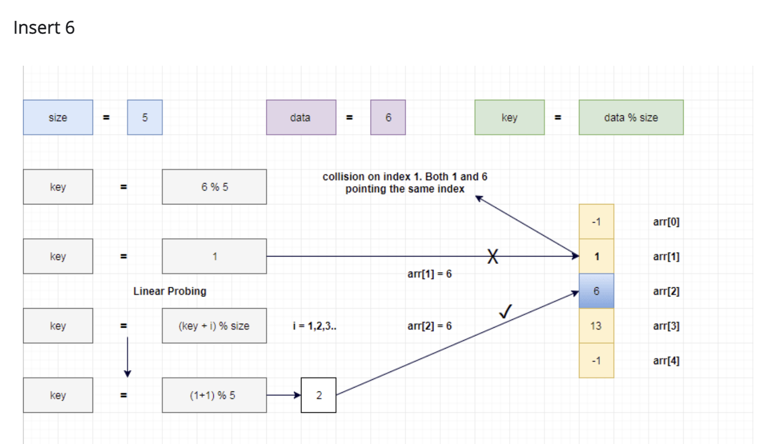
Insert 6

Slide 10
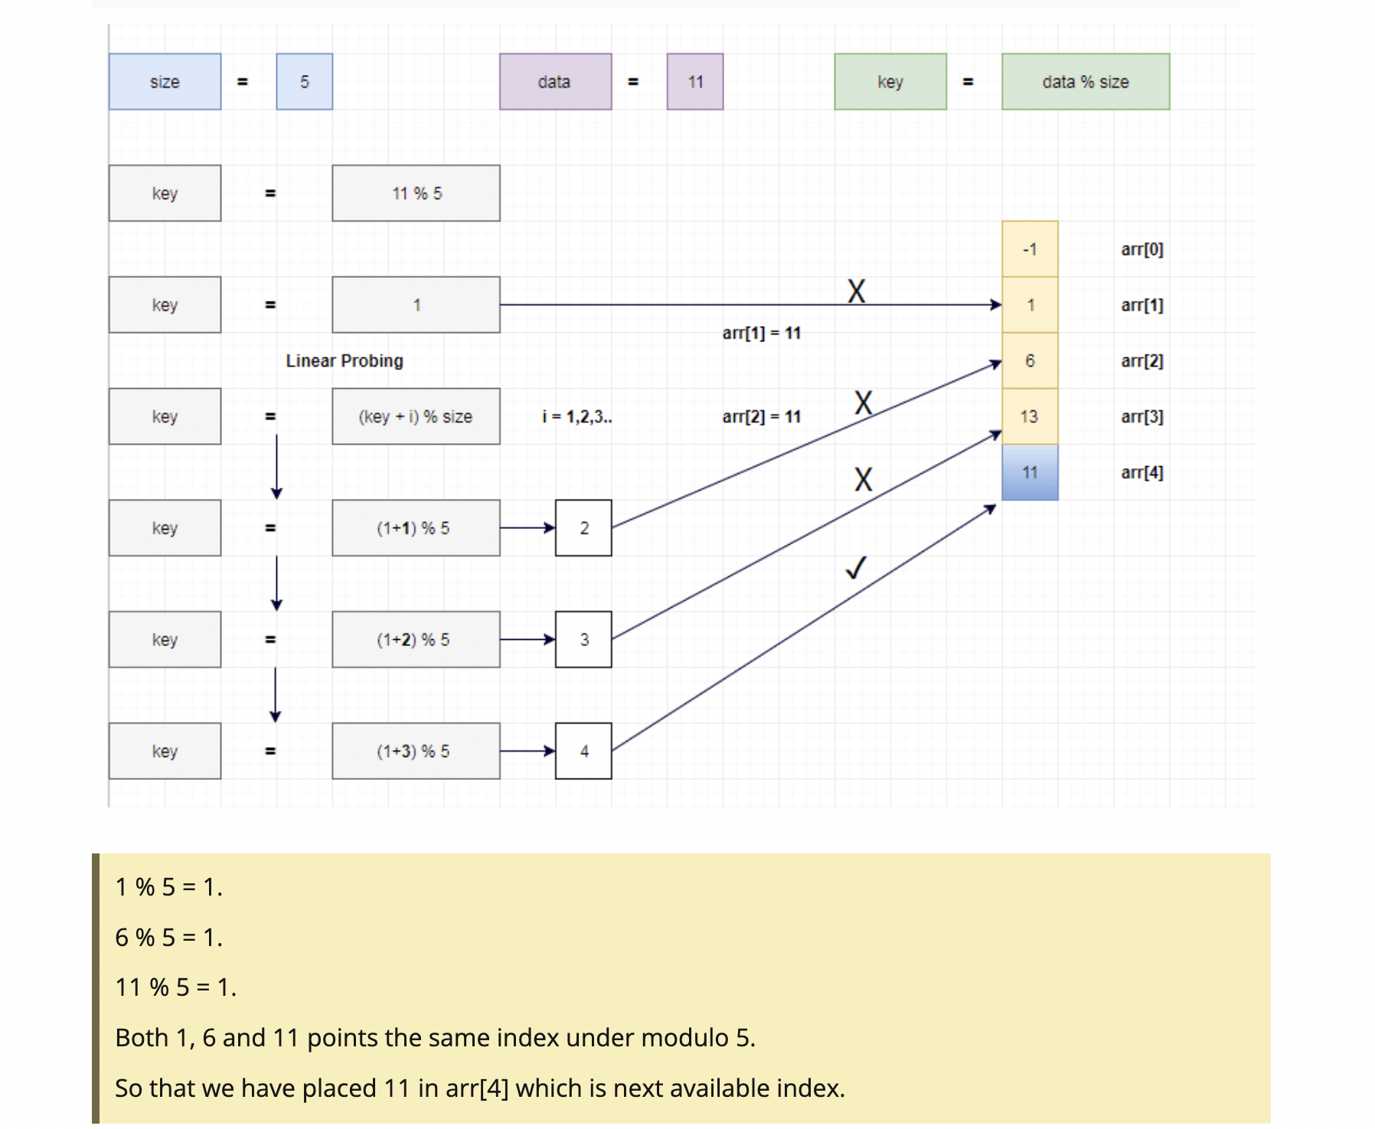
Insert 11

Slide 11
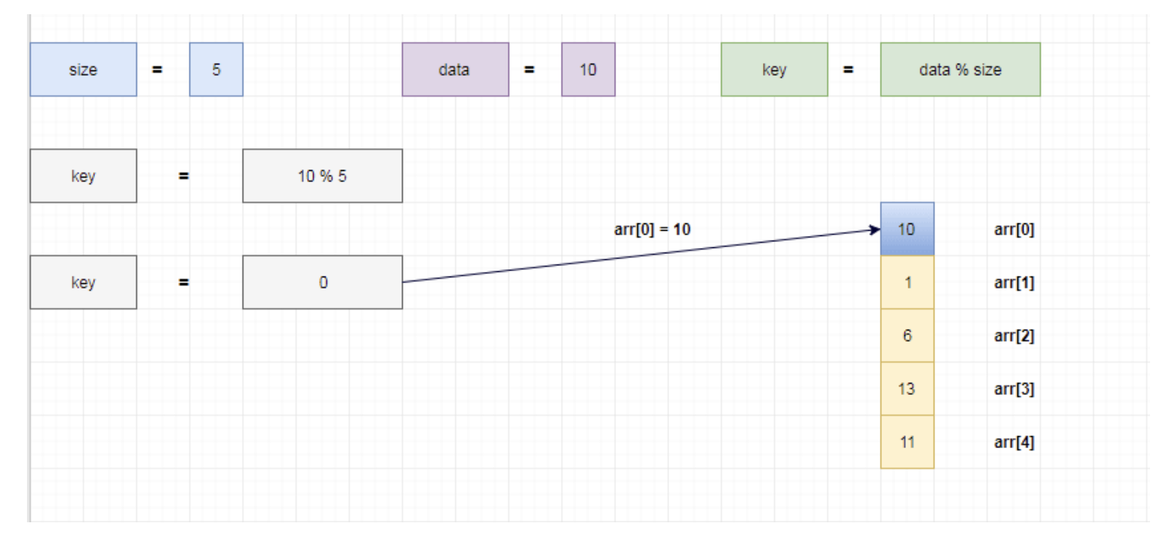
Insert 10

Slide 12
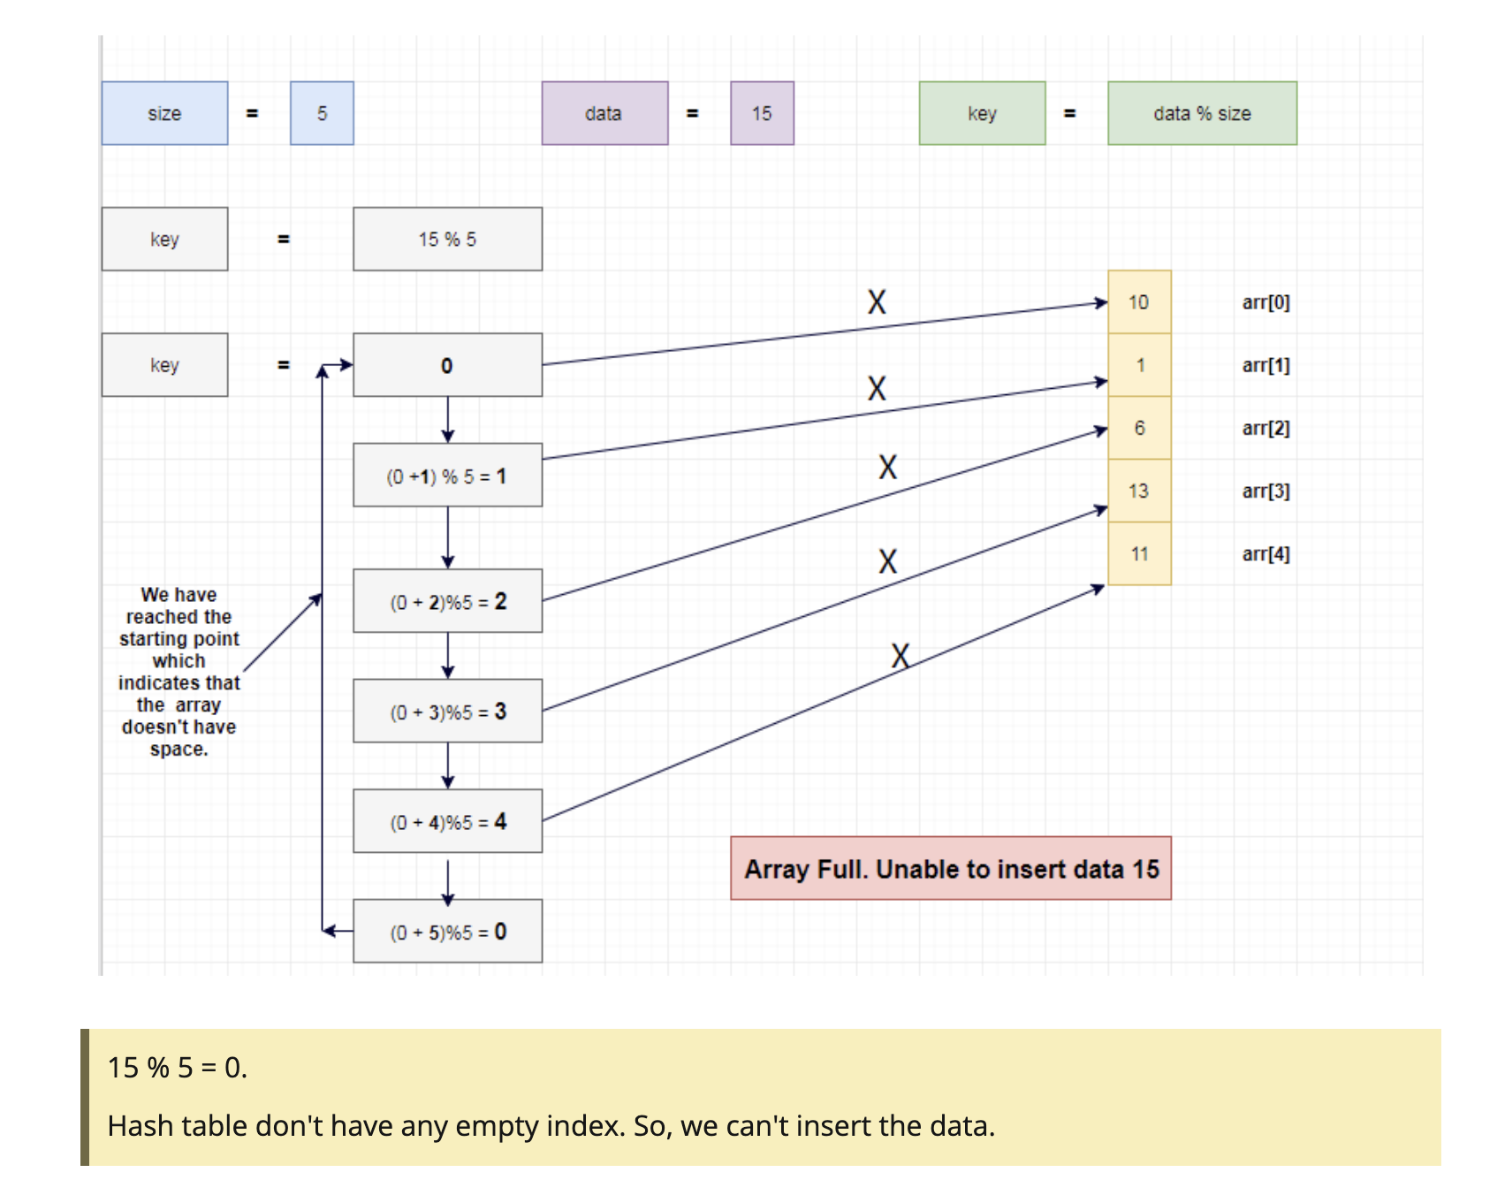
Insert 15

Slide 13
•Advantage:-
1.No extra space required.
•Disadvantage:-
1.Searching time.
2.Deletion of value from hash table.
-> Tombstone deletion markers.
3.Primary clustering.
4.Secondary clustering.
-> Same probe sequence.
-> k1 - 1,2,3,... & k2 - 1,2,3,...

Slide 14
Linear probing with chaining
1)It is one of the collision resolution technique.
2)In this technique we extend a linked list at node where collision has occurred.

Slide 15
Linear probing with chaining
without replacement
{9,45,13,12,88,11,75,59,105,46}
index | key | chain
0 |  | -1
1 | 11 | -1
2 | 12 | -1
3 | 13 | -1
4 |  | -1
5 | 45 | -1
6 |  | -1
7 |  | -1
8 | 88 | -1
9 | 9 | -1

Slide 16
{9,45,13,59,12,75,88,11,105,46}
index | key | chain
0 |  | -1
1 | 11 | -1
2 | 12 | -1
3 | 13 | -1
4 |  | -1
5 | 45 | -1
6 |  | -1
7 |  | -1
8 | 88 | -1
9 | 9 | -1
index | key | chain
0 | 59 | -1
1 | 11 | -1
2 | 12 | -1
3 | 13 | -1
4 |  | -1
5 | 45 | 6
6 | 75 | 7
7 | 105 | -1
8 | 88 | -1
9 | 9 | 0

Slide 17
{9,45,13,59,12,75,88,11,105,46}
index | key | chain
0 | 59 | -1
1 | 11 | -1
2 | 12 | -1
3 | 13 | -1
4 |  | -1
5 | 45 | 6
6 | 75 | 7
7 | 105 | -1
8 | 88 | -1
9 | 9 | 0
index | key | chain
0 | 59 | -1
1 | 11 | -1
2 | 12 | -1
3 | 13 | -1
4 | 46 | -1
5 | 45 | 6
6 | 75 | 7
7 | 105 | -1
8 | 88 | -1
9 | 9 | 0

Slide 18
Linear probing with chaining
with replacement :
 | key | chain
0 |  | -1
1 |  | -1
2 |  | -1
3 | 13 | -1
4 |  | -1
5 | 45 | -1
6 |  | -1
7 |  | -1
8 |  | -1
9 | 9 | -1
{9,45,13,59,12,75,88,11,105,46}

Slide 19
{9,45,13,59,12,75,88,11,105,46}
 | key | chain
0 | 59 | -1
1 |  | -1
2 | 12 | -1
3 | 13 | -1
4 |  | -1
5 | 45 | -1
6 |  | -1
7 |  | -1
8 |  | -1
9 | 9 | 0
 | key | chain
0 | 59 | -1
1 | 11 | -1
2 | 12 | -1
3 | 13 | -1
4 |  | -1
5 | 45 | 6
6 | 75 | 7
7 | 105 | -1
8 | 88 | -1
9 | 9 | -1

Slide 20
 | key | chain
0 | 59 | -1
1 | 11 | -1
2 | 12 | -1
3 | 13 | -1
4 | 75 | -1
5 | 45 | 6
6 | 46 | 7
7 | 105 | 4
8 | 88 | -1
9 | 9 | 0
{9,45,13,59,12,75,88,11,105,46}

Slide 21



